Slide 1
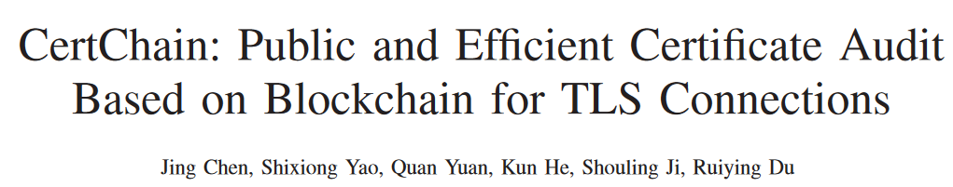
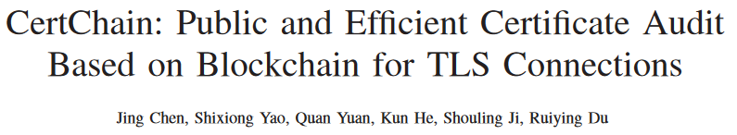
INFOCOM 2018

Slide 2
1.INTRODUCTION
Transport Layer Security (TLS) protocol
Public Key Infrastructure(PKI)
*certificate authorities(CAs)
*CAs’ vulnerability
TurkTrust, CNNIC(中国互联网络信息中心), DSDtestProvider
Blockchain, a distributed database that is used to maintain a continuously growing list of records.
A comprehensive certificate management system based on blockchain.

Slide 3
Record certificates and their associated certificate operations for public audit, respond to attacks quickly.
Blockchain brings three important challenges:
1. Centralization in practice
2. Mandatory traversal
3. Block size limitation
Contributions:
1. CertChain can resist certificate forgery and tamper attacks effectively.
2. A distributed dependability-rank based consensus protocol
3. CertOper is stored in block for operations forward traceability and
efficient query.
4. a revocation checking method based on Dual counting bloom filter (DCBF)
which can markedly eliminate false positives
5. implement a proof-of-concept prototype and evaluate the performance of
CertChain in practice.

Slide 4
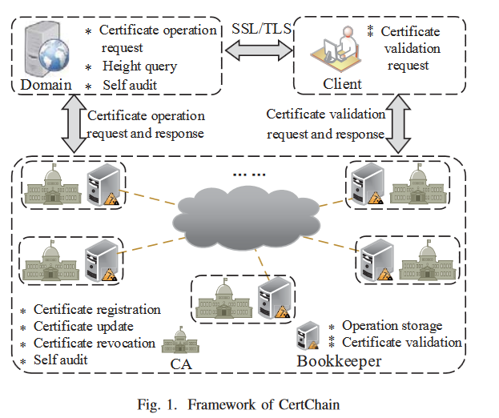
2.PROBLEM STATEMENT
A. System Model
*
*
*
*

Slide 5
2.PROBLEM STATEMENT
B. Threat Model
1.issue a certificate for a malicious domain without being detected
2. insert, delete, or tamper the certificate operations for making
clients’ certificate validation failure;
3. control the blockchain by attacking some bookkeepers.
1.Consensus fairness
By dynamic accommodation, each bookkeeper has a similar probability to generate blocks for recording certificate operations.
2.High query efficiency
All operations of a specified certificate can be traced without traversing the whole blockchain.
3. Intrusion tolerance
Through self audit CA can detect misbehavior effectively by querying blockchain
C. Design Goals

Slide 6
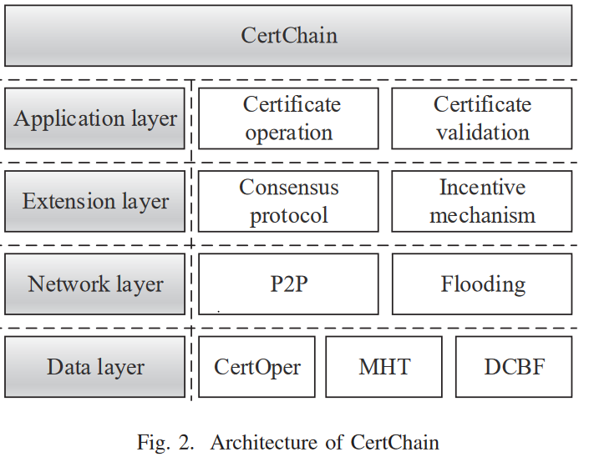
3.CertChian Design

Slide 7
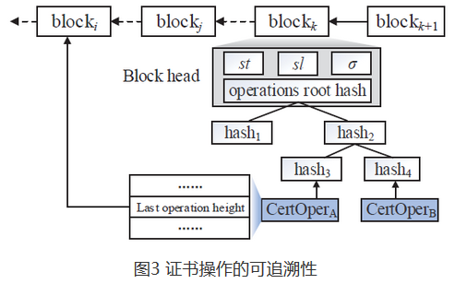
A.Data layer
CertOper :X.509 public key
express a concrete certificate operation requested by a domain
Operator Name Operation Type
Current Certificate Hash Last Operation Height
DCBF-Dual Counting Bloom Filter
A revocation checking method that utilizes the DCBF to eliminate false positive

Slide 8
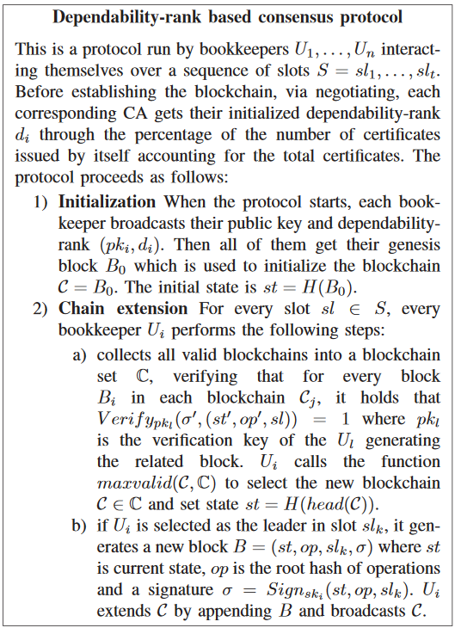
B.Extension layer
Dependability-rank based consensus protocol
Incentive mechanism

Slide 9
B.Extension layer
Dependability-rank based consensus protocol
Incentive mechanism
CA shares the dependability-rank di with the corresponding bookkeeper.
Dependability-rank affects the probability of leader election among bookkeepers
CA issues a valid certificate, generates related operation, or reports an entity’s misbehavior, it will be rewarded with dependability-rank
CA signs illegal certificate or issuing forge revocation information will be punished in the form of a reduction in dependability-rank

Slide 10
C.Application layer
Certificate registration update revocation validation
registration update
revocation
CertOper ==》CertChian
CertOper remove from CBF1
CertOper ==》CBF1
CertOper ==》 CBF2

Slide 11
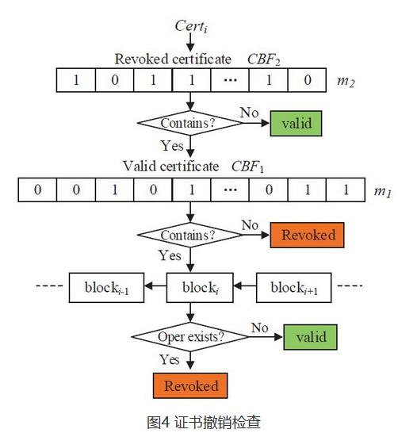
C.Application layer
Certificate registration update revocation validation
registration update
revocation

Slide 12
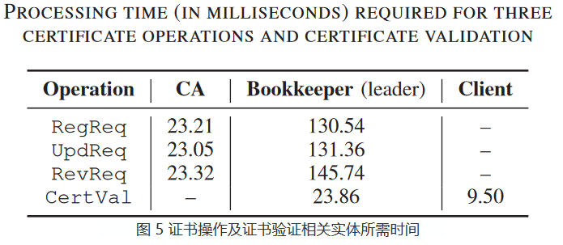
4.EXPERIMENT AND EVALUATION
Bookkeepers’ implementation is based on Ethereum
block size 2MB, 6.7s ,a single CertOper is about 1.8KB
assume we have one million certificates, and under 5% revoked certificates
size of the DCBF about 412KB
all CertOper and DCBF are stored in a block

Slide 13
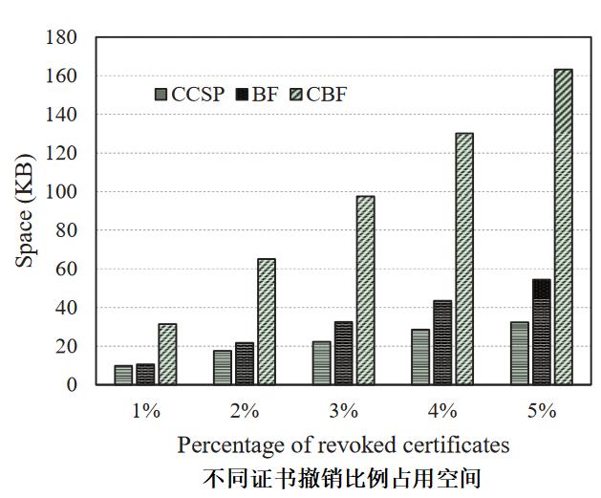
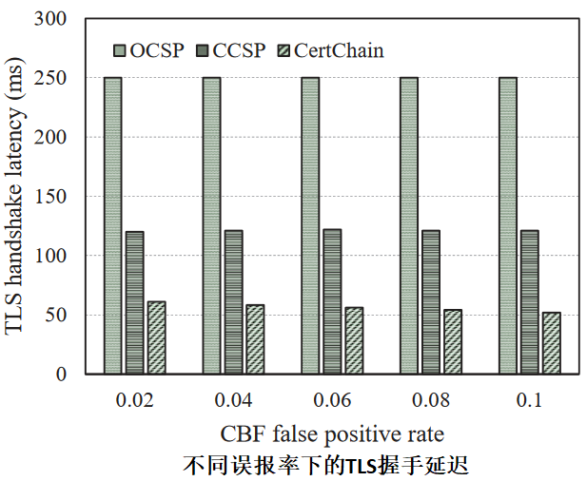
4.EXPERIMENT AND EVALUATION
CCSP(bitmap)
CBF replaces the bit(BF) with counter
CBF:compared the size of a block, this space requirement is acceptable
TLS handshakes latency depends on the efficiency of revocation checking service

